Slide 1

UGS Staff Attrition Report, 2025
By Paul Uviase
December 2025

Slide 2
Table of Contents
Introduction
Problem Statement
Task 1: Which departments recorded the highest employee attrition?
Task 2: What are the top Reasons for Attrition
Task 3: Which Location(s) recorded the Highest Attrition
Task 4: Which education levels are most at risk of attrition due to unmet career growth expectations?
Task 5: Who is More Likely to Leave(Based on Marital Status?
Conclusion
Task 6: Does Salary Drive Attrition?

Slide 3

Introduction

Slide 4

Introducing UGS (The Client)
UGS LTD is a leading Nigerian producer of Cooking Oil, Seasoning, Cocoa Beverages, and confectionery, with branches across key towns. Operating through departments such as Operations, HR, IT, Finance, Sales, and Marketing. The company strives for efficiency and quality in all its products.
With rising operational costs and increasing competition for talent, employee retention has become critical to sustaining productivity and growth. This report examines employee attrition trends to provide insights for strategic workforce planning and retention initiatives.

Slide 5

Problem Statement

Slide 6
Problem Statement
Employee attrition has become a growing concern, driven by factors such as the rising cost of living, salary competitiveness, workload pressure, and limited career advancement opportunities. Currently, management lacks data-driven insights into why employees leave, when they leave, and which employee segments are most at risk. This gap often leads to reactive and less effective retention decisions.
To address this, the business has engaged me(Paul Uviase) to leverage its existing data to provide actionable insights and solutions to its most pressing workforce challenges.
Business Objectives (Key Questions)
1. Which departments recorded the highest employee attrition?
2. What are the top Reasons for Attrition
3. Which Location(s) recorded the Highest Attrition
4. Which education levels are most at risk of attrition due to unmet career growth expectations?
Who is More Likely to Leave(Based on Marital Status?
Does Salary Drive Attrition?

Slide 7
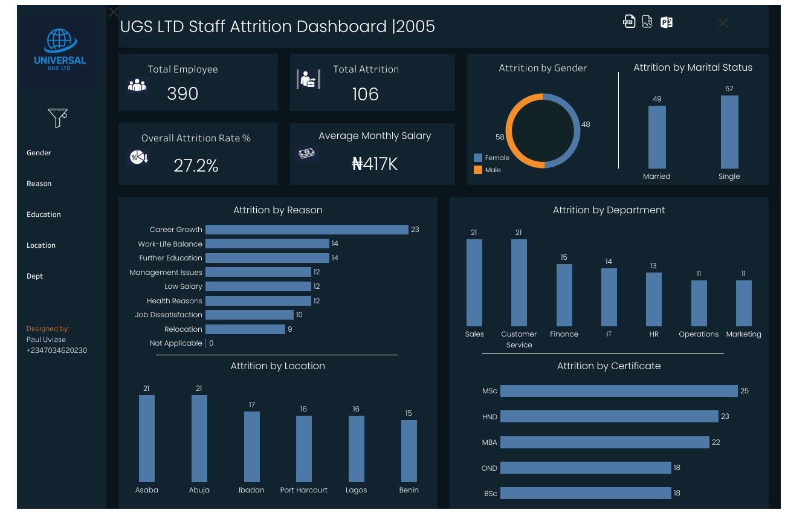
Dashboard Report

Slide 8

Analysis:

Slide 9
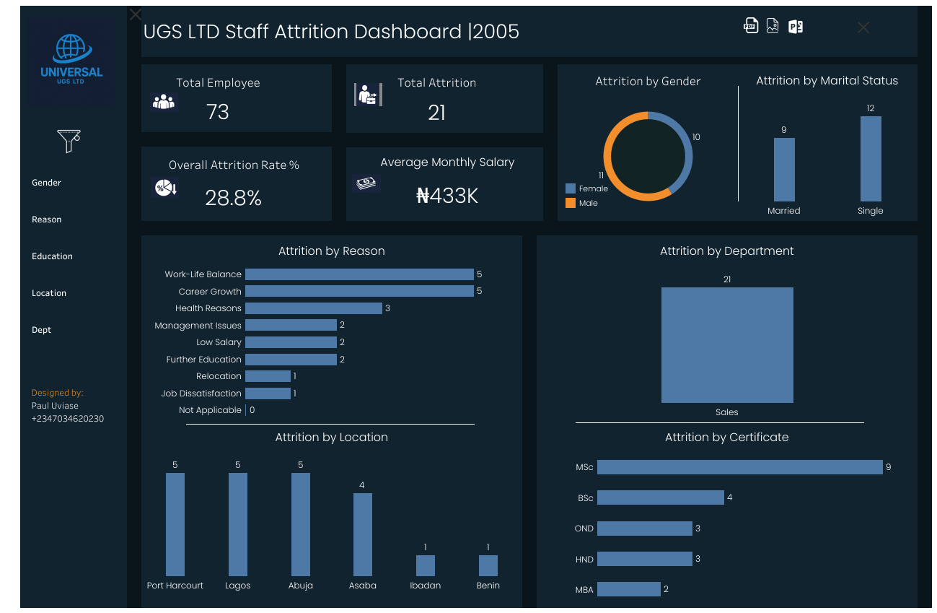
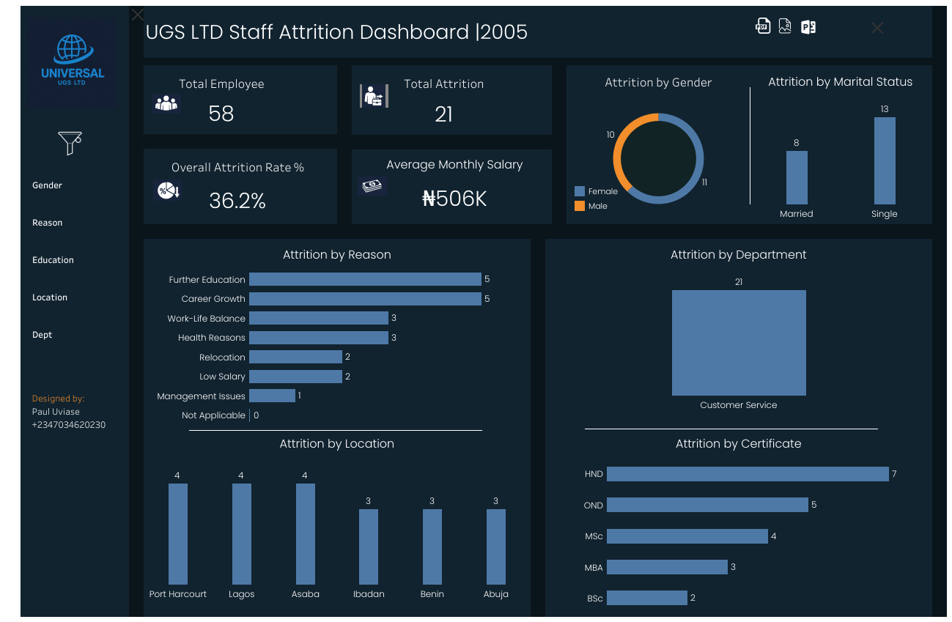
Task 1: Attrition by Department (Highest)
Sales Department Attrition: 21
Customer Services Department Attrition: 21

Slide 10
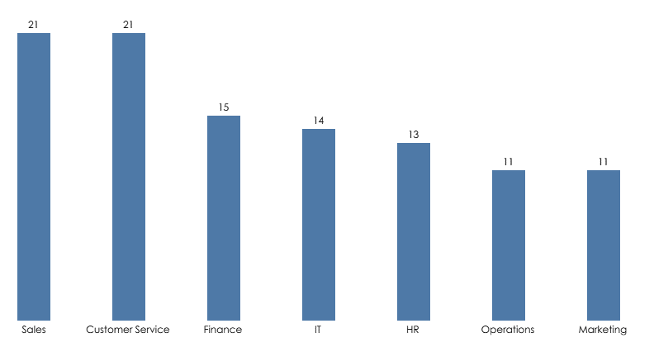
Task 1: Which departments and job roles record the highest employee attrition?
Finding
Sales and Customer Service recorded the highest attrition (21 exits each),
Insight
Both functions are frontline, high-pressure roles with constant performance monitoring, customer-facing stress, and limited downtime. Unlike back-office roles, employees in Sales and Customer Service experience:
Continuous emotional labour
High rejection or complaint exposure
Performance targets that reset frequently
When these pressures are not balanced with clear progression, recognition, and support, attrition becomes inevitable rather than accidental.

Slide 11

Attrition by Department: Recommendation(s)/ Expected End
Recommendation
Redesign performance metrics to reward consistency and service quality, not just volume
Introduce structured career paths from Customer Service → Sales, → Supervisory roles
Deploy burnout-mitigation tools (rotational shifts, mental wellness check-ins, team incentives)
Expected End
This will help to reduce Sales and Customer Service attrition, stabilise revenue inflow and customer experience, while lowering repeated hiring and training costs.

Slide 12
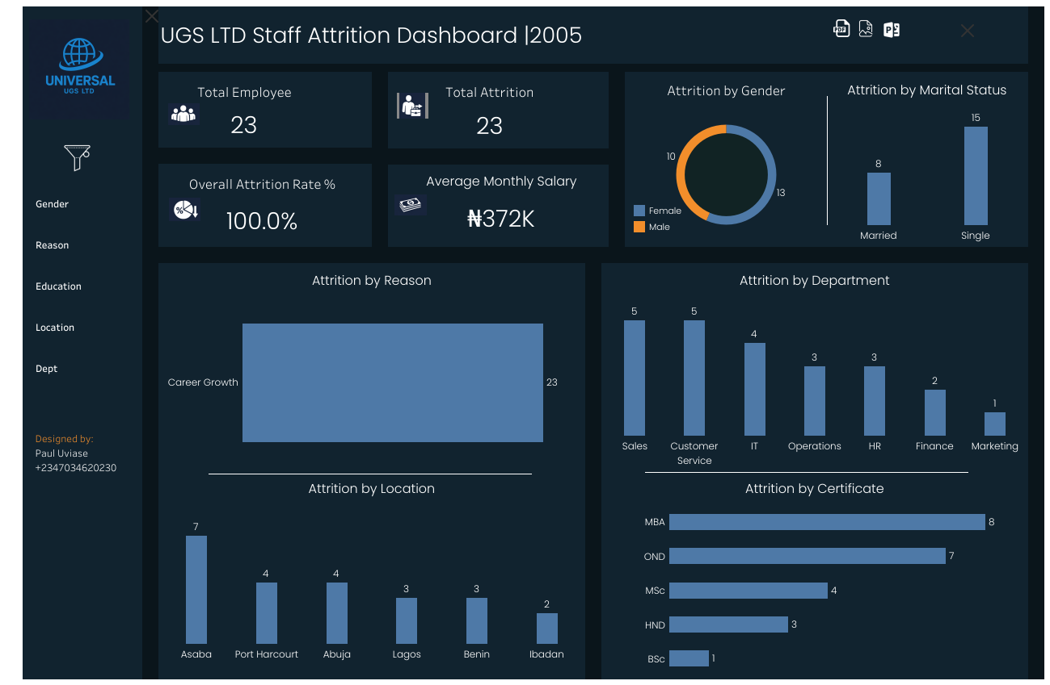
Task 2: Attrition by Reason(Highest)

Slide 13
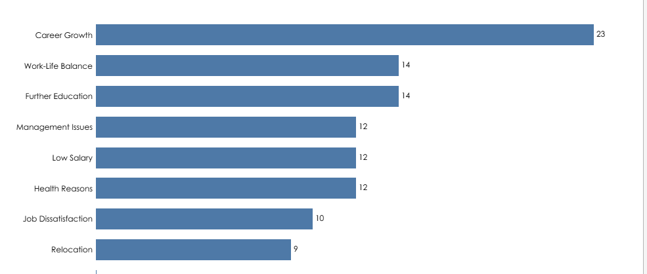
Task 2: What are the top Reasons for Attrition
Finding Attrition is driven mainly by limited career growth (23), followed by work–life balance (14) and further education (14). Management issues, low salary, and health reasons each account for 12. MBA holders have the highest attrition here.
Insight Employees are not leaving because they are unhappy today—they are leaving because they cannot see tomorrow. Once career visibility disappears, attrition becomes a matter of timing, not probability.

Slide 14

Attrition by Reason: Recommendation(s) Expected End
Recommendation
Define clear career progression pathways for each role
Publish promotion criteria and internal mobility opportunities
Introduce structured learning and leadership development tracks
Expected End This will encourage employees to begin to plan their future within the organisation rather than outside it, directly reducing voluntary exits driven by uncertainty.

Slide 15
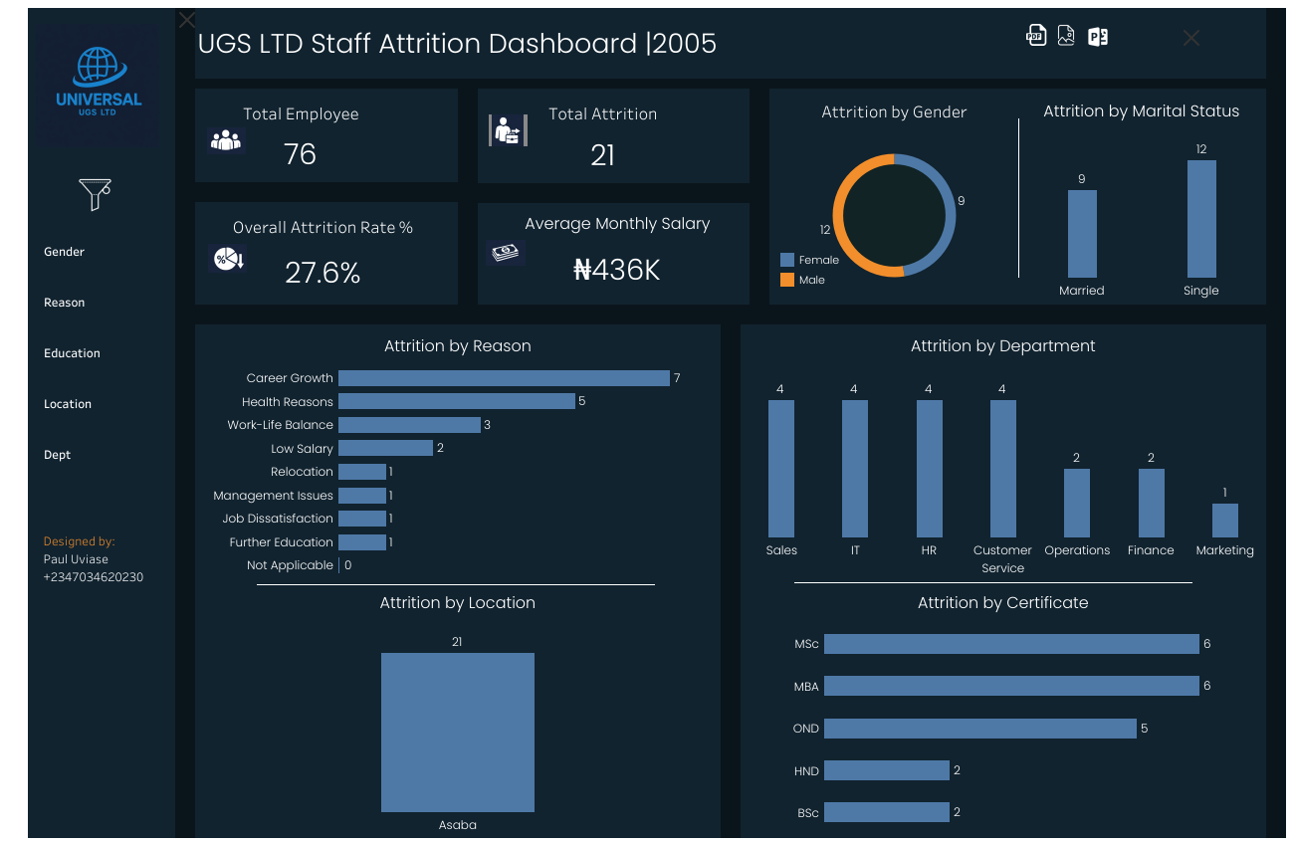
Task 3: Attrition by Location (Highest)

Slide 16
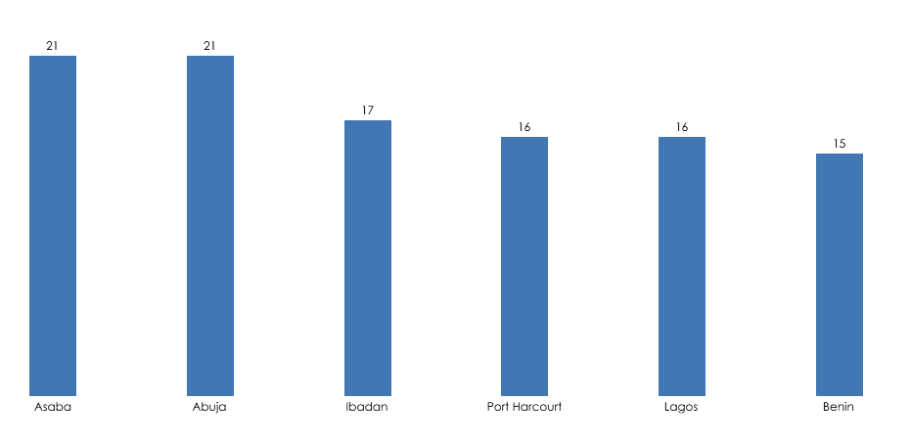
Task 3: Which Location(s) recorded the Highest Attrition
Finding
Asaba and Abuja record the highest attrition levels with 21, respectively, while Benin records the lowest.
MSC holders recorded the highest attrition in Abuja and Asaba
Insight
High-attrition locations are losing employees not simply because of geography or workload, but because they place highly qualified (MSC and MBA) staff in high-pressure environments that offer limited strategic exposure and career progression. These employees recognise the mismatch quickly, making such locations exit points rather than career-building postings.

Slide 17

Attrition by Location: Recommendation(s)/ Expected End
Recommendation
Redesign roles in high-attrition locations to include decision ownership and strategic exposure
Assign MSC/MBA holders to location-specific improvement projects
Strengthen branch leadership to mentor and retain advanced-degree talent
Expected End
If the above recommendations are implemented, it will help slow attrition while improving operational effectiveness.

Slide 18
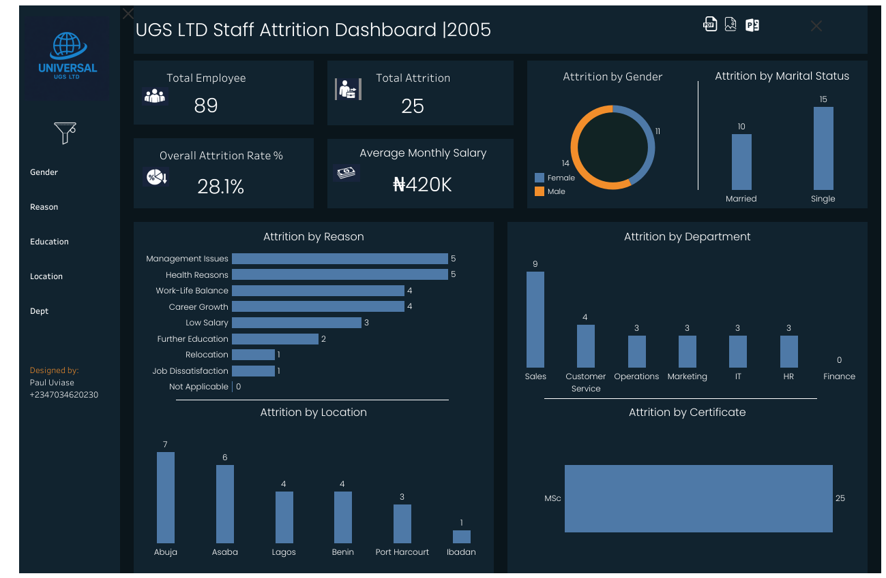
Task 4: Attrition by Education (Highest)

Slide 19
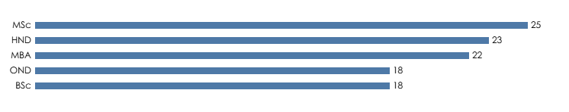
Task 4: Which education levels are most at risk of attrition due to unmet career growth expectations?
Finding Employees with higher qualifications show the highest attrition, led by MSc holders (25), followed by HND (23) and MBA (22), while OND (18) and BSc (18) record comparatively lower exits.
Insight Highly educated employees have higher career velocity expectations. When roles remain static, they interpret stagnation as underutilisation of their skills.

Slide 20

Attrition by Education: Recommendation(s)/ Expected End
Recommendation
Fast-track development plans for highly qualified employees
Assign strategic projects that stretch capability and create dual career paths (technical and managerial)
Expected End
UGS will retain its intellectual capital while improving succession planning and leadership pipeline depth if the recommendation is implemented.

Slide 21
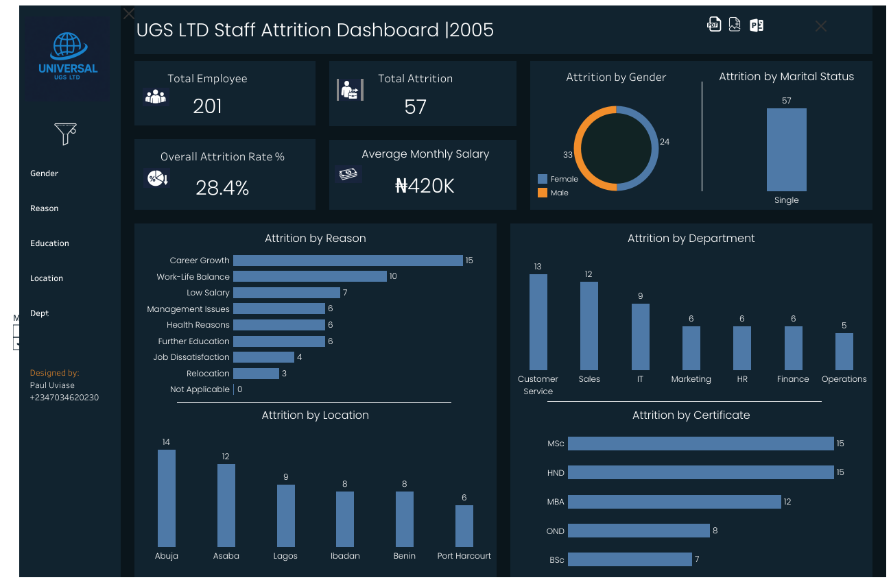
Task 5: Attrition by Marital Status (Highest)

Slide 22
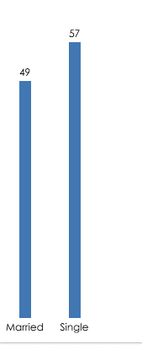
Task 5: Who is More Likely to Leave(Based on Marital Status?
Finding Single employees show a slightly higher attrition rate compared to married employees.
Insight Single employees tend to be more career-mobile, less location-bound, and quicker to respond to external job opportunities offering faster growth or better compensation.

Slide 23
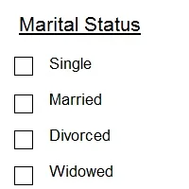
Attrition by Marital Status: Recommendation(s) / Expected End
Recommendation
Design targeted retention strategies for high-mobility talent
Offer skill-based incentives, certifications, and rapid role expansion
Increase engagement frequency for early-career employees
Expected End
When implemented, UGS will convert mobility risk into innovation energy, retaining top young talent while still allowing flexibility.

Slide 24
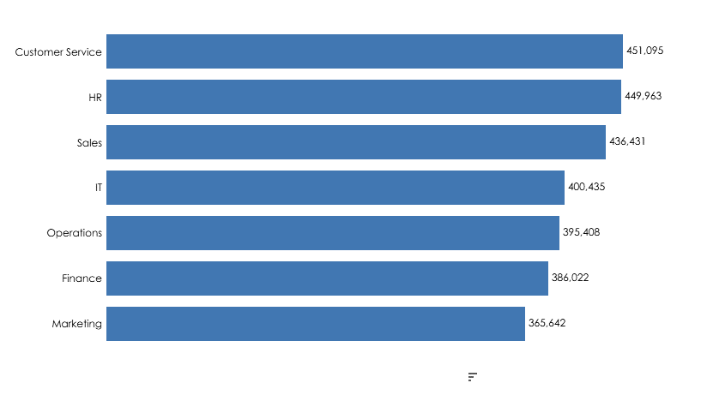

Task 5: Does Salary drive Attrition?
Finding
The average monthly salary is ₦417K. While low salary contributes to exits, it is not the dominant attrition driver.
Insight
Employees are not leaving solely because of pay, but because compensation is perceived as misaligned with workload, growth opportunities, and leadership quality.

Slide 25

Attrition by Salary: Recommendation(s) / Expected End
Recommendation
Reposition compensation as part of a broader value proposition
Link rewards to progression milestones, not tenure alone
Expected End
Implementing the above recommendation will help reduce overall attrition

Slide 26

Key Takeaways & Recommendations (Way Forward for UGS Ltd)

Slide 27

Conclusion
Employee attrition at UGS LTD is not a failure of loyalty—it is a signal of misalignment between employee expectations and organisational systems.
By implementing the recommended actions, UGS can transform attrition from a cost centre into a competitive workforce strategy, strengthening productivity, stability, and long-term growth.
Recommendations

Slide 28
Thank You!

